Slide 1
Wireless Networking Technologies

Slide 2
What You Should Already know
OSI Model
TCP/IP Model
Packet and Circuit Switching
Multiplexing
Types of Medium and their characteristics
Basics of Transmission e.g. models of transmission, types etc.
WiFi and Ethernet etc.
Delays and its types -----------??
Addressing and its types-----------??
IP and its versions-------------------??

Slide 3
The great pleasure in life is doing what people say you cannot do

Slide 4
Short History
Use of light in ancient times
Smoke signals (150 BC)
Start of electromagnetic waves in 1830s
Marconi (1874-1937) demonstration of wireless telegraphy in 1895
First radio broadcast in 1906
1907, commercial transatlantic connections were setup (huge antennas were used)

Slide 5
Short History
1915 – first wireless voice setup between Washington and San Francisco.
1920 – first commercial radio (still huge antennas and high power)
1920 – Marconi discover short waves (reflection – ionosphere)
1926 – First telephone on train between Berlin-Hamburg
1927 – first commercial car radio

Slide 6
Short History
1927 – TV broadcast starts
Up until 1933, amplitude modulation was used – poor quality due to interference
1933 – frequency modulation by E.H. Armstrong
1958 – first wireless network in Germany was analog A-Netz, carrier frequency of 160MHz,
  Connection establishment from mobile station only
  No handovers
1971 – A-Netz had 80% coverage with 11,000 customers

Slide 7
Short History
1972 – B-Netz using the same frequency 160MHz
  Connection establishment from fixed phones as well
1979 – Denmark, Finland, Norway and Sweden agreed on Nordic Mobile Telephone (NMT)
  450 MHz
  Latter on NMT 900MHz in 1986

Slide 8
Short History
1982 – pan European Mobile Phone system aiming at
  New spectrum at 900MHz
  Allow roaming through out europe
  Be fully digital
  Offer voice and data services
Global system for Mobile (GSM) was founded

Slide 9
Short History
1983 – AMPS- Advance Mobile Phone System working at 850MHz (IS-88)
1984 - CT1 – Cordless telephones (followed by its predecessors CT0 -1980)
1985-90 – C-Netz with support of handovers
1991 – fully digital systems

Slide 10
Short History
DECT – Digital European Cordless Telephones
  100-500 meters range
  120 duplex channels
  1.2Mbps for data transmission
  Support several 10,000 users/km2
  Used in more than 40 countries
  Renamed as Digital Enhanced Cordless Telecomm

Slide 11
Short History
1991 – GSM was standardized
  900 MHz
  124 full duplex channels
  Full international roaming
  9.6kbps data rate
  13kbps voice rate
GSM 1800
In US no standardization results in different systems IN US
  AMPS (IS-88)
  TDMA (IS-136)
  CDMA (IS-95)

Slide 12
Short History
GSM at 1800 MHz also called DCS 1800
US uses GSM at 1900 MHz called PCS1900
1996 HIPERLAN – HIgh PErformance Radio Local Area Network
1997 – 802.11 @ 2.4GHz
1998 – beginning of mobile communication using satellite with Iridium System
  Consist of 66 satellite in LEO at 1.6GHz

Slide 13
Short History
1998 – European agreed on UMTS Universal Mobile Telecommunication System at 2GHz and 2Mbps
1999 – several powerful WLANs
802.11b at 2.4GHz @11Mbps
802.11a at 5GHz @ 54Mbps
2000 – packet oriented transmission GPRS, HSCSD
2001 – 3G system started in Japan

Slide 14
Short History
2002 – 802.11g at 2.4GHz and 54Mbps and many Bluetooth applications
Nov 2002 – Digital TV terrestrial (DVB-T) in Berlin
High quality TV on the move and require an antenna of few centimeters

Slide 15
Limitations of the mobile environment
Limitations of the Wireless Network
  limited communication bandwidth
  frequent disconnections
  heterogeneity of fragmented networks
Limitations Imposed by Mobility
  route breakages
  lack of mobility awareness by system/applications
Limitations of the Mobile Device
  short battery lifetime
  limited capacities
Sridhar Iyer
IIT Bombay

Slide 16
Mobile communication
Wireless vs. mobile Examples
✗ ✗ stationary computer
✗ ✓ laptop in a hotel (portable)
✓ ✗ wireless LAN in historic buildings
✓ ✓ Personal Digital Assistant (PDA)
Integration of wireless into existing fixed networks:
  Local area networks: IEEE 802.11, ETSI (HIPERLAN)
  Wide area networks: Cellular 3G, IEEE 802.16
  Internet: Mobile IP extension

Slide 17
Wireless v/s Wired networks
Regulations of frequencies
  Limited availability, coordination is required
  useful frequencies are almost all occupied
Bandwidth and delays
  Low transmission rates
    few Kbits/s to some Mbit/s.
  Higher delays
    several hundred milliseconds
  Higher loss rates
    susceptible to interference, e.g., engines, lightning
Always shared medium
  Lower security, simpler active attacking
  radio interface accessible for everyone
  secure access mechanisms important
Sridhar Iyer
IIT Bombay

Slide 18
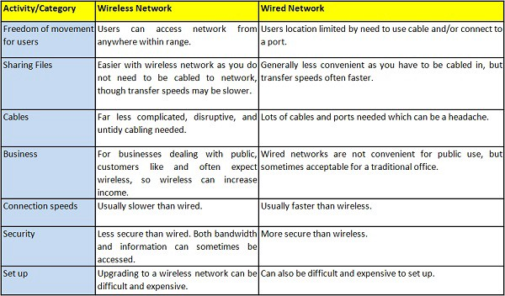
Wireless v/s Wired networks

Slide 19
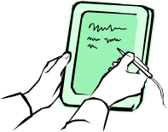
Reference model
Application
Application
Transport
Transport
Network
Network
Network
Network
Data Link
Data Link
Data Link
Data Link
Physical
Physical
Physical
Physical
Radio
Medium
Sridhar Iyer
IIT Bombay

Slide 20
Effect of mobility on protocol stack
Application
  new applications and adaptations
  service location, multimedia
Transport
  congestion and flow control
  quality of service
Network
  addressing and routing
  device location, hand-over
Link
  media access and security
Physical
  transmission errors and interference
Sridhar Iyer
IIT Bombay

Slide 21
Perspectives
Network designers: Concerned with cost-effective design
  Need to ensure that network resources are efficiently utilized and fairly allocated to different users.
Network users: Concerned with application services
  Need guarantees that each message sent will be delivered without error within a certain amount of time.
Network providers: Concerned with system administration
  Need mechanisms for security, management, fault-tolerance and accounting.
Sridhar Iyer
IIT Bombay

Slide 22
RF Basics

Slide 23
Factors affecting wireless system design
Frequency allocations
  What range to operate? May need licenses.
Multiple access mechanism
  How do users share the medium without interfering?
Antennas and propagation
  What distances? Possible channel errors introduced.
Signals encoding
  How to improve the data rate?
Error correction
  How to ensure that bandwidth is not wasted?
Sridhar Iyer
IIT Bombay

Slide 24
Frequencies for communication
VLF = Very Low Frequency UHF = Ultra High Frequency
LF = Low Frequency SHF = Super High Frequency
MF = Medium Frequency EHF = Extra High Frequency
HF = High Frequency UV = Ultraviolet Light
VHF = Very High Frequency
Frequency and wave length
  λ = c/f
  wave length λ, speed of light c ≅ 3x108m/s, frequency f
twisted pair
coax cable
optical transmission
1 Mm
300 Hz
10 km
30 kHz
100 m
3 MHz
1 m
300 MHz
10 mm
30 GHz
100 μm
3 THz
1 μm
300 THz
VLF
LF
MF
HF
VHF
UHF
SHF
EHF
infrared
visible light
UV
Prof. Dr.-Ing. Jochen H. Schiller www.jochenschiller.de MC - 2015
Notes:
Universität Karlsruhe
Institut für Telematik
Mobilkommunikation
SS 1998
Prof. Dr. Dr. h.c. G. Krüger
E. Dorner / Dr. J. Schiller

Slide 25
Example frequencies for mobile communication
VHF-/UHF-ranges for mobile radio
  simple, small antenna for cars
  deterministic propagation characteristics, reliable connections
SHF and higher for directed radio links, satellite communication
  small antenna, beam forming
  large bandwidth available
Wireless LANs use frequencies in UHF to SHF range
  some systems planned up to EHF
  limitations due to absorption by, e.g., water (dielectric heating, see microwave oven)
    weather dependent fading, signal loss caused by heavy rainfall etc.
Prof. Dr.-Ing. Jochen H. Schiller www.jochenschiller.de MC - 2015
Notes:
Universität Karlsruhe
Institut für Telematik
Mobilkommunikation
SS 1998
Prof. Dr. Dr. h.c. G. Krüger
E. Dorner / Dr. J. Schiller

Slide 26
Frequencies and regulations
Examples | Europe | USA | Japan
Cellular networks | GSM 880-915, 925-960, 1710-1785, 1805-1880 UMTS 1920-1980, 2110-2170 LTE 791-821, 832-862, 2500-2690 | AMPS, TDMA, CDMA, GSM 824-849, 869-894 TDMA, CDMA, GSM, UMTS 1850-1910, 1930-1990 | PDC, FOMA 810-888, 893-958 PDC 1429-1453, 1477-1501 FOMA 1920-1980, 2110-2170
Cordless phones | CT1+ 885-887, 930-932 CT2 864-868 DECT 1880-1900 | PACS 1850-1910, 1930-1990 PACS-UB 1910-1930 | PHS 1895-1918 JCT 245-380
Wireless LANs | 802.11b/g 2412-2472 | 802.11b/g 2412-2462 | 802.11b 2412-2484 802.11g 2412-2472
Other RF systems | 27, 128, 418, 433, 868 | 315, 915 | 426, 868
In general: ITU-R holds auctions for new frequencies, manages frequency bands worldwide (WRC, World Radio Conferences); 3GPP specific: see e.g. 3GPP TS 36.101 V11.4.0 (2013-03)
Prof. Dr.-Ing. Jochen H. Schiller www.jochenschiller.de MC - 2015
Notes:
Universität Karlsruhe
Institut für Telematik
Mobilkommunikation
SS 1998
Prof. Dr. Dr. h.c. G. Krüger
E. Dorner / Dr. J. Schiller

Slide 27
Signals I
Physical representation of data
Function of time and location
Signal parameters: parameters representing the value of data
Classification
  continuous time/discrete time
  continuous values/discrete values
  analog signal = continuous time and continuous values
  digital signal = discrete time and discrete values
Signal parameters of periodic signals:
  period T, frequency f=1/T, amplitude A, phase shift ϕ
  sine wave as special periodic signal for a carrier:
  s(t) = A_{t} sin(2 π f_{t} t + ϕ_{t})
Prof. Dr.-Ing. Jochen H. Schiller www.jochenschiller.de MC - 2015
Notes:
Universität Karlsruhe
Institut für Telematik
Mobilkommunikation
SS 1998
Prof. Dr. Dr. h.c. G. Krüger
E. Dorner / Dr. J. Schiller

Slide 28
Antennas

Slide 29
Antennas
An antenna is an electrical conductor or system of conductors to send/receive RF signals
  Transmission - radiates electromagnetic energy into space
  Reception - collects electromagnetic energy from space
In two-way communication, the same antenna can be used for transmission and reception
Omnidirectional Antenna
(lower frequency)
Directional Antenna (higher frequency)
Sridhar Iyer
IIT Bombay

Slide 30
Antenna
Couples Electromagnetic energy to and from space and from a wire or coaxial cable.
Real antennas have directive effect
Directive antennas are used to over come the environmental challenges

Slide 31
Antenna
Two or more antennas can be combine to improve reception called multi-element antenna array
Antennas should be apart
2

Slide 32
MIMO
Multiple-Input Multiple-Output
  Use of several antennas at receiver and transmitter
  Increased data rates and transmission range without additional transmit power or bandwidth via higher spectral efficiency, higher link robustness, reduced fading
Examples
  IEEE 802.11n, LTE, HSPA+, …
Functions
  “Beamforming”: emit the same signal from all antennas to maximize signal power at receiver antenna
  Spatial multiplexing: split high-rate signal into multiple lower rate streams and transmit over different antennas
  Diversity coding: transmit single stream over different antennas with (near) orthogonal codes
t₁
t₃
3
1
t₂
sender
Time of flight
t₂=t₁+d₂
t₃=t₁+d₃
Sending time
1: t₀
2: t₀-d₂
3: t₀-d₃
2
receiver
Prof. Dr.-Ing. Jochen H. Schiller www.jochenschiller.de MC - 2015

Slide 33
Wireless transmission
Antenna
Antenna
Transmitter
Receiver
Wireless communication systems consist of:
  Transmitters
  Antennas: radiates electromagnetic energy into air
  Receivers
In some cases, transmitters and receivers are on same device, called transceivers.
Sridhar Iyer
IIT Bombay

Slide 34
Transmitters
Antenna
Amplifier
Mixer
Filter
Amplifier
Source
Oscillator
Transmitter
Suppose you want to generate a signal that is sent at 900 MHz and
the original source generates a signal at 300 MHz.
  Amplifier - strengthens the initial signal
  Oscillator - creates a carrier wave of 600 MHz
  Mixer - combines signal with oscillator and produces 900 MHz (also does modulation, etc)
  Filter - selects correct frequency
  Amplifier - Strengthens the signal before sending it
Sridhar Iyer
IIT Bombay

Slide 35
Signal Propagation and Modulation

Slide 36
Signals
physical representation of data
Layer 1 is responsible for data <--> signal
function of time and location
signal parameters: parameters representing the value of data
classification
  continuous time/discrete time
  continuous values/discrete values
  analog signal = continuous time and continuous values
  digital signal = discrete time and discrete values
signal parameters of periodic signals:
period T, frequency f=1/T, amplitude A, phase shift ϕ
  sine wave as special periodic signal for a carrier:
  s(t) = A_{t} sin(2 π f_{t} t + ϕ_{t})

Slide 37
Signal Propagation
Wired comm have direction of propagation ie follow the medium
Not the case in wireless,
No uniform medium characteristics for wireless
The situation can be
  Transmission range
  Detection range
  Interference range

Slide 38
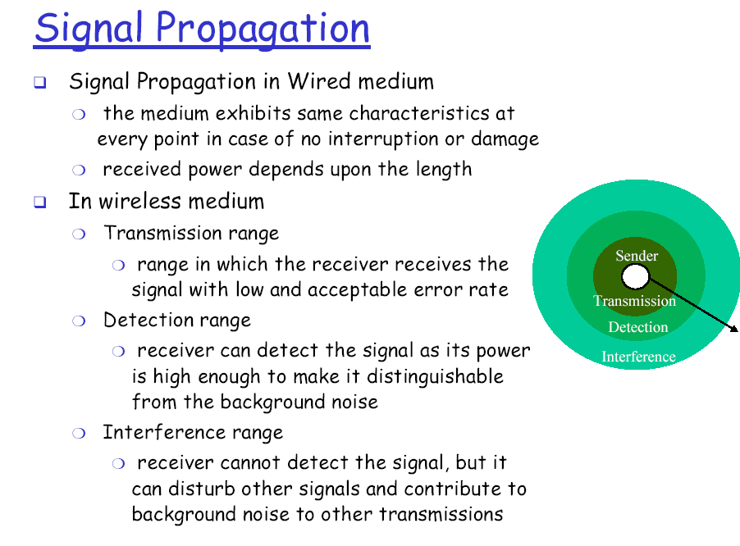

Slide 39




Signal propagation
Propagation in free space always like light (straight line)
Receiving power proportional to 1/d² in vacuum – much more attenuation in real environments, e.g., d^{3.5}…d⁴
(d = distance between sender and receiver)
Receiving power additionally influenced by
  fading (frequency dependent)
  shadowing
  reflection at large obstacles
  refraction depending on the density of a medium
  scattering at small obstacles
  diffraction at edges
shadowing
reflection
refraction
scattering
diffraction
Prof. Dr.-Ing. Jochen H. Schiller www.jochenschiller.de MC - 2015
Notes:
Universität Karlsruhe
Institut für Telematik
Mobilkommunikation
SS 1998
Prof. Dr. Dr. h.c. G. Krüger
E. Dorner / Dr. J. Schiller

Slide 40
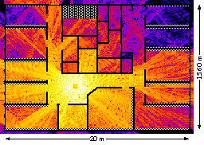
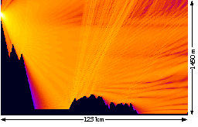
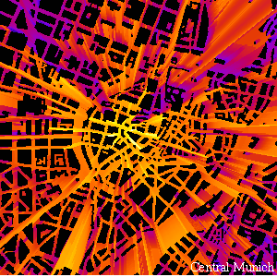
Real world examples
www.ihe.kit.edu/index.php
Prof. Dr.-Ing. Jochen H. Schiller www.jochenschiller.de MC - 2015
Notes:
Universität Karlsruhe
Institut für Telematik
Mobilkommunikation
SS 1998
Prof. Dr. Dr. h.c. G. Krüger
E. Dorner / Dr. J. Schiller

Slide 41
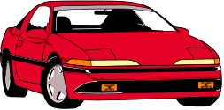
Multipath propagation
Signal can take many different paths between sender and receiver due to reflection, scattering, diffraction
Time dispersion: signal is dispersed over time
  interference with “neighbor” symbols, Inter Symbol Interference (ISI)
The signal reaches a receiver directly and phase shifted
  distorted signal depending on the phases of the different parts
LOS pulses
multipath
pulses
LOS
(line-of-sight)
signal at sender
signal at receiver
Prof. Dr.-Ing. Jochen H. Schiller www.jochenschiller.de MC - 2015
Notes:
Universität Karlsruhe
Institut für Telematik
Mobilkommunikation
SS 1998
Prof. Dr. Dr. h.c. G. Krüger
E. Dorner / Dr. J. Schiller

Slide 42
Effects of mobility
Channel characteristics change over time and location
  signal paths change
  different delay variations of different signal parts
  different phases of signal parts
➔ quick changes in the power received (short term fading)
Additional changes in
  distance to sender
  obstacles further away
➔ slow changes in the average power received (long term fading)
power
long term
fading
t
short term fading
Prof. Dr.-Ing. Jochen H. Schiller www.jochenschiller.de MC - 2015
Notes:
Universität Karlsruhe
Institut für Telematik
Mobilkommunikation
SS 1998
Prof. Dr. Dr. h.c. G. Krüger
E. Dorner / Dr. J. Schiller

Slide 43
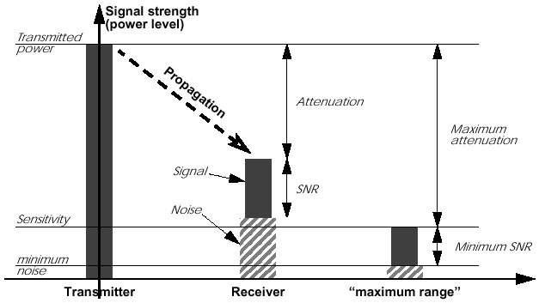
Attenuation: Propagation & Range
Sridhar Iyer
IIT Bombay

Slide 44
Attenuation
Strength of signal falls off with distance over transmission medium
Attenuation factors for unguided media:
  Received signal must have sufficient strength so that circuitry in the receiver can interpret the signal
  Signal must maintain a level sufficiently higher than noise to be received without error
  Attenuation is greater at higher frequencies, causing distortion
Approach: amplifiers that strengthen higher frequencies
Sridhar Iyer
IIT Bombay

Slide 45
Modulation
What is modulation and types of modulation?
Process of converting data into electrical signals optimized for transmission.
roughly divided into four types:
  Analog modulation
  Digital modulation
  Pulse modulation
  Spread spectrum method
Sridhar Iyer
IIT Bombay

Slide 46
Modulation and demodulation
analog
baseband
signal
digital
data
digital
modulation
analog
modulation
101101001
radio transmitter
radio
carrier
analog
baseband
signal
digital
data
analog
demodulation
synchronization
decision
101101001
radio receiver
radio
carrier
Sridhar Iyer
IIT Bombay

Slide 47
Modulation
Digital modulation
  digital data is translated into an analog signal (baseband)
  ASK, FSK, PSK
  differences in spectral efficiency, power efficiency, robustness
Analog modulation
  shifts center frequency of baseband signal up to the radio carrier
Motivation
  smaller antennas (e.g., λ/4)
  Frequency Division Multiplexing
  medium characteristics
Basic schemes
  Amplitude Modulation (AM)
  Frequency Modulation (FM)
  Phase Modulation (PM)
Sridhar Iyer
IIT Bombay

Slide 48
Digital modulation
Modulation of digital signals known as Shift Keying
Amplitude Shift Keying (ASK):
  very simple
  low bandwidth requirements
  very susceptible to interference
Frequency Shift Keying (FSK):
  needs larger bandwidth
Phase Shift Keying (PSK):
  more complex
  robust against interference
Many advanced variants
1
0
1
t
1
0
1
t
1
0
1
t
Sridhar Iyer
IIT Bombay

Slide 49
OFDM (Orthogonal Frequency Division)
Parallel data transmission on several orthogonal subcarriers with lower rate
c
k₃
f
t
Maximum of one subcarrier frequency appears exactly at a frequency where all other subcarriers equal zero
  superposition of frequencies in the same frequency range
Amplitude
subcarrier:
SI function=
sin(x)
x
f
Sridhar Iyer
IIT Bombay

Slide 50
Multiplexing Mechanisms

Slide 51
Multiplexing
channels k_{i}
k₁
k₂
k₃
k₄
k₅
k₆
c
Multiplexing in 4 dimensions
  space (s_{i})
  time (t)
  frequency (f)
  code (c)
Goal: multiple use
of a shared medium
Important: guard spaces needed!
t
c
s₁
t
s₂
f
f
c
t
s₃
f
Sridhar Iyer
IIT Bombay

Slide 52
Frequency multiplex
Separation of the whole spectrum into smaller frequency bands
A channel gets a certain band of the spectrum for the whole time
Advantages:
no dynamic coordination
necessary
works also for analog signals
Disadvantages:
waste of bandwidth
if the traffic is
distributed unevenly
inflexible
guard spaces
k₁
k₂
k₃
k₄
k₅
k₆
c
f
t
Sridhar Iyer
IIT Bombay

Slide 53
Time multiplex
A channel gets the whole spectrum for a certain amount of time
Advantages:
only one carrier in the
medium at any time
throughput high even
for many users
Disadvantages:
precise
synchronization
necessary
k₁
k₂
k₃
k₄
k₅
k₆
c
f
t
Sridhar Iyer
IIT Bombay

Slide 54
Time and frequency multiplex
Combination of both methods
A channel gets a certain frequency band for a certain amount of time
Example: GSM
Advantages:
  better protection against
  tapping
  protection against frequency
  selective interference
  higher data rates compared to
  code multiplex
but: precise coordination
required
k₁
k₂
k₃
k₄
k₅
k₆
c
f
t
Sridhar Iyer
IIT Bombay

Slide 55
Code multiplex
Each channel has a unique code
All channels use the same spectrum at the same time
Advantages:
  bandwidth efficient
  no coordination and synchronization necessary
  good protection against interference and tapping
Disadvantages:
  lower user data rates
  more complex signal regeneration
Implemented using spread spectrum technology
k₁
k₂
k₃
k₄
k₅
k₆
c
f
t
Sridhar Iyer
IIT Bombay

Slide 56
CDMA Example
  D = rate of data signal
  Break each bit into k chips
    Chips are a user-specific fixed pattern
  Chip data rate of new channel = kD
If k=6 and code is a sequence of 1s and -1s
  For a ‘1’ bit, A sends code as chip pattern
    <c1, c2, c3, c4, c5, c6>
  For a ‘0’ bit, A sends complement of code
    <-c1, -c2, -c3, -c4, -c5, -c6>
Receiver knows sender’s code and performs electronic decode function
    <d1, d2, d3, d4, d5, d6> = received chip pattern
    <c1, c2, c3, c4, c5, c6> = sender’s code
Sridhar Iyer
IIT Bombay

Slide 57
CDMA Example
User A code = <1, –1, –1, 1, –1, 1>
  To send a 1 bit = <1, –1, –1, 1, –1, 1>
  To send a 0 bit = <–1, 1, 1, –1, 1, –1>
User B code = <1, 1, –1, – 1, 1, 1>
  To send a 1 bit = <1, 1, –1, –1, 1, 1>
Receiver receiving with A’s code
  (A’s code) x (received chip pattern)
    User A ‘1’ bit: 6 -> 1
    User A ‘0’ bit: -6 -> 0
    User B ‘1’ bit: 0 -> unwanted signal ignored
Sridhar Iyer
IIT Bombay

Slide 58
Cell structure
Implements space division multiplex
  base station covers a certain transmission area (cell)
Mobile stations communicate only via the base station
Advantages of cell structures
  higher capacity, higher number of users
  less transmission power needed
  more robust, decentralized
  base station deals with interference, transmission area etc. locally
Problems
  fixed network needed for the base stations
  handover (changing from one cell to another) necessary
  interference with other cells
Cell sizes from some 100 m in cities to, e.g., 35 km on the country side (GSM) - even less for higher frequencies
Prof. Dr.-Ing. Jochen H. Schiller www.jochenschiller.de MC - 2015
Notes:
Universität Karlsruhe
Institut für Telematik
Mobilkommunikation
SS 1998
Prof. Dr. Dr. h.c. G. Krüger
E. Dorner / Dr. J. Schiller

Slide 59
Frequency planning I
Frequency reuse only with a certain distance between the base stations
Standard model using 7 frequencies:
Fixed frequency assignment:
  certain frequencies are assigned to a certain cell
  problem: different traffic load in different cells
Dynamic frequency assignment:
  base station chooses frequencies depending on the frequencies already used in neighbor cells
  more capacity in cells with more traffic
  assignment can also be based on interference measurements
f₃
f₅
f₂
f₄
f₆
f₅
f₁
f₄
f₃
f₇
f₁
f₂
Prof. Dr.-Ing. Jochen H. Schiller www.jochenschiller.de MC - 2015
Notes:
Universität Karlsruhe
Institut für Telematik
Mobilkommunikation
SS 1998
Prof. Dr. Dr. h.c. G. Krüger
E. Dorner / Dr. J. Schiller

Slide 60
Frequency planning II
f₃
f₃
f₃
f₂
f₂
f₁
f₁
f₁
f₂
f₃
f₇
f₃
f₃
3 cell cluster
f₅
f₂
f₂
f₂
f₂
f₄
f₆
f₅
f₁
f₁
f₁
f₄
f₃
f₃
f₃
f₃
f₇
f₁
f₂
f₃
f₆
f₅
f₂
7 cell cluster
f₁
f₂
f₁
f₂
f₁
f₂
f₃
h₂
f₃
h₂
f₃
3 cell cluster
with 3 sector antennas
h₁
h₁
g₂
h₃
g₂
h₃
g₂
g₁
g₁
g₁
g₃
g₃
g₃
Prof. Dr.-Ing. Jochen H. Schiller www.jochenschiller.de MC - 2015
Notes:
Universität Karlsruhe
Institut für Telematik
Mobilkommunikation
SS 1998
Prof. Dr. Dr. h.c. G. Krüger
E. Dorner / Dr. J. Schiller

Slide 61
Cell breathing
CDM systems: cell size depends on current load
Additional traffic appears as noise to other users
If the noise level is too high users drop out of cells
Prof. Dr.-Ing. Jochen H. Schiller www.jochenschiller.de MC - 2015
Notes:
Universität Karlsruhe
Institut für Telematik
Mobilkommunikation
SS 1998
Prof. Dr. Dr. h.c. G. Krüger
E. Dorner / Dr. J. Schiller

